Slide 1

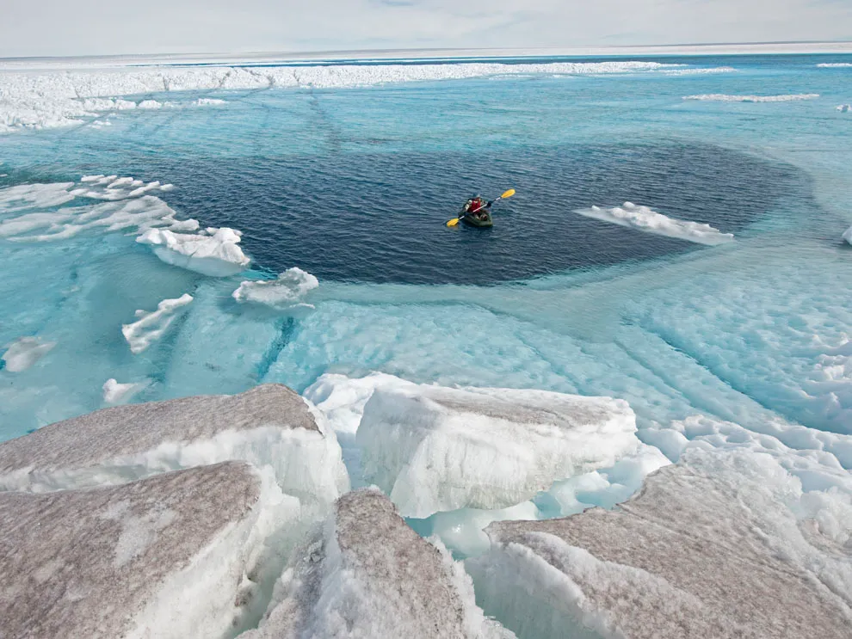
A subglacial hydrology model with blisters following supraglacial lake drainages
Hanwen Zhang, Laura Stevens, Ian Hewitt
Background
subglacial hydrology model: nevis
blister model & dynamics
Results
2-dimensional subglacial hydrology
Discussions & future work
Credit to James Balog, National Geographic

Slide 2
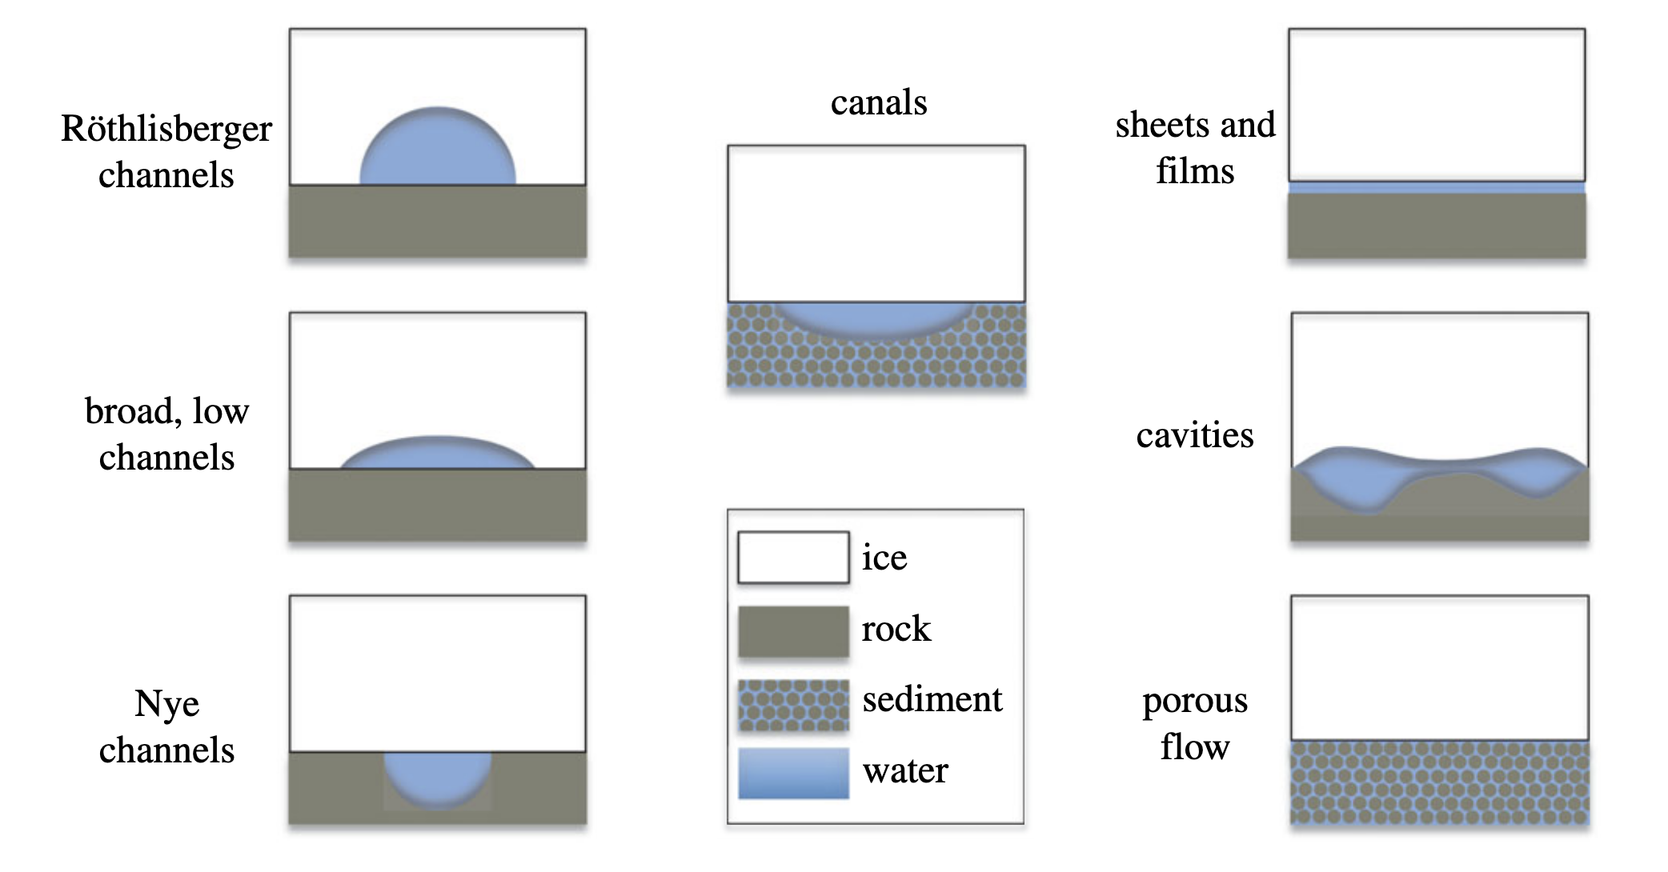
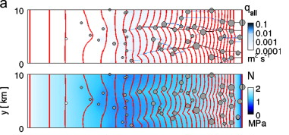
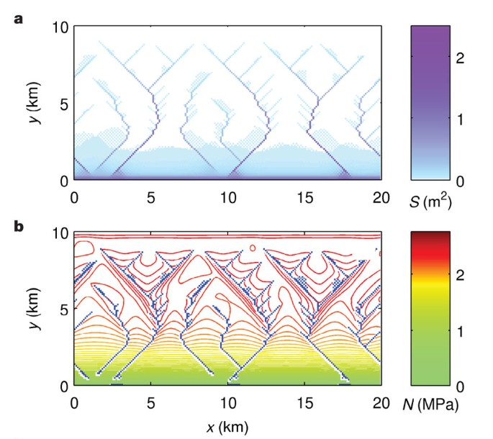
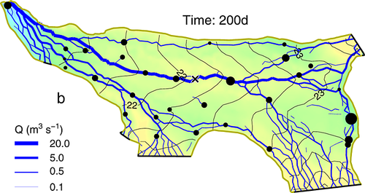
Subglacial hydrology & the model
A subglacial drainage system consists of …
Multi-element model
channels (efficient)
cavities, porous flow,
sheets and films (inefficient)
…
a “slow” cavity and a “fast” channel
Hewitt, 2013
Schoof, 2010
Flowers, 2015
Werder et al., 2013
But there is something not included above …

Slide 3
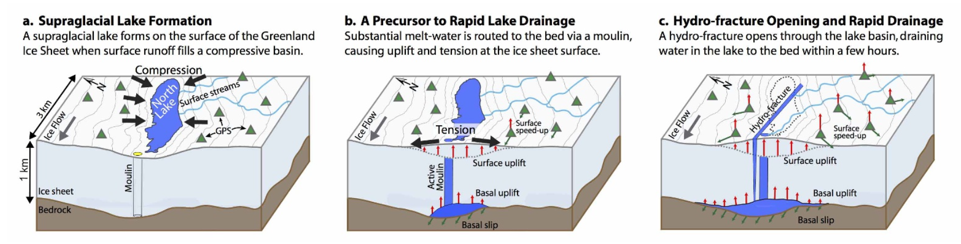
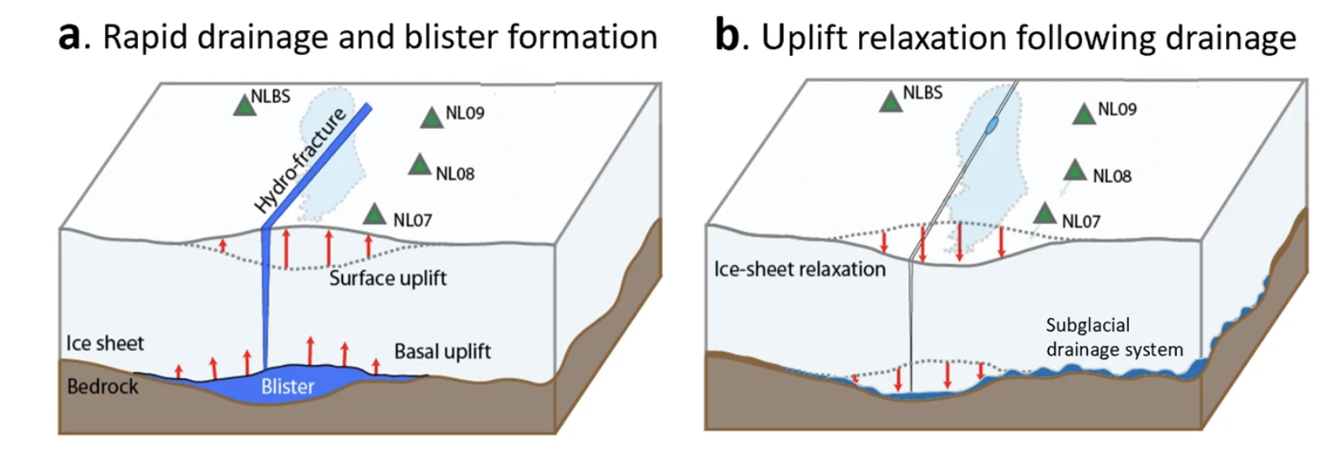
Blister formation following Supraglacial lake drainages
Stevens et al., 2015
Initially the blister collects water from the lake, followed by a relaxation due to leakage to the surroundings
Lai et al., 2021

Slide 4
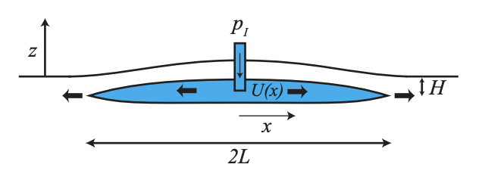
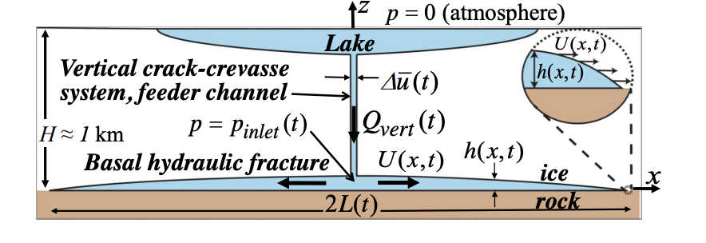
Modelling a subglacial blister
Hydrofracture model of a subglacial blister (i.e., Tsai and Rice, 2012, Rice et al., 2015)
Attempt to incorporate blister with a subglacial hydrology model (Dow et al., 2015)
Use a hydrofracture model to expand a blister, which is then used as an initial condition to evolve a subglacial hydrology flow-line model.
Can we find a way to account for blisters in a 2-d subglacial hydrology/ice sheet model?
Tsai and Rice, 2012
Rice et al., 2015

Slide 5
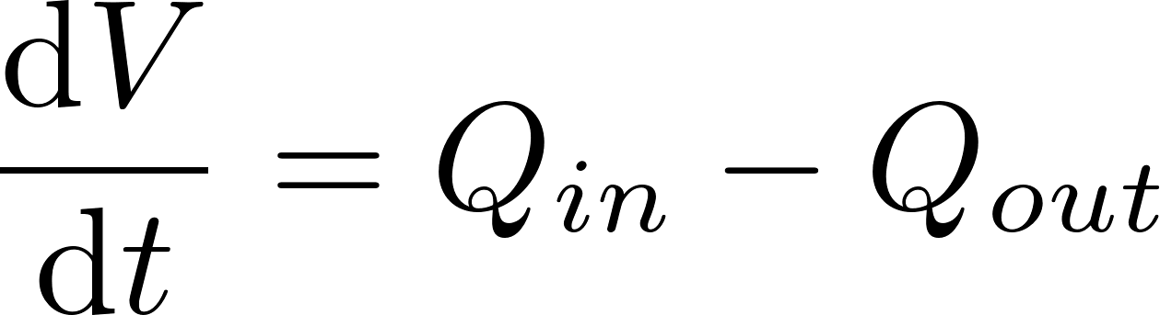
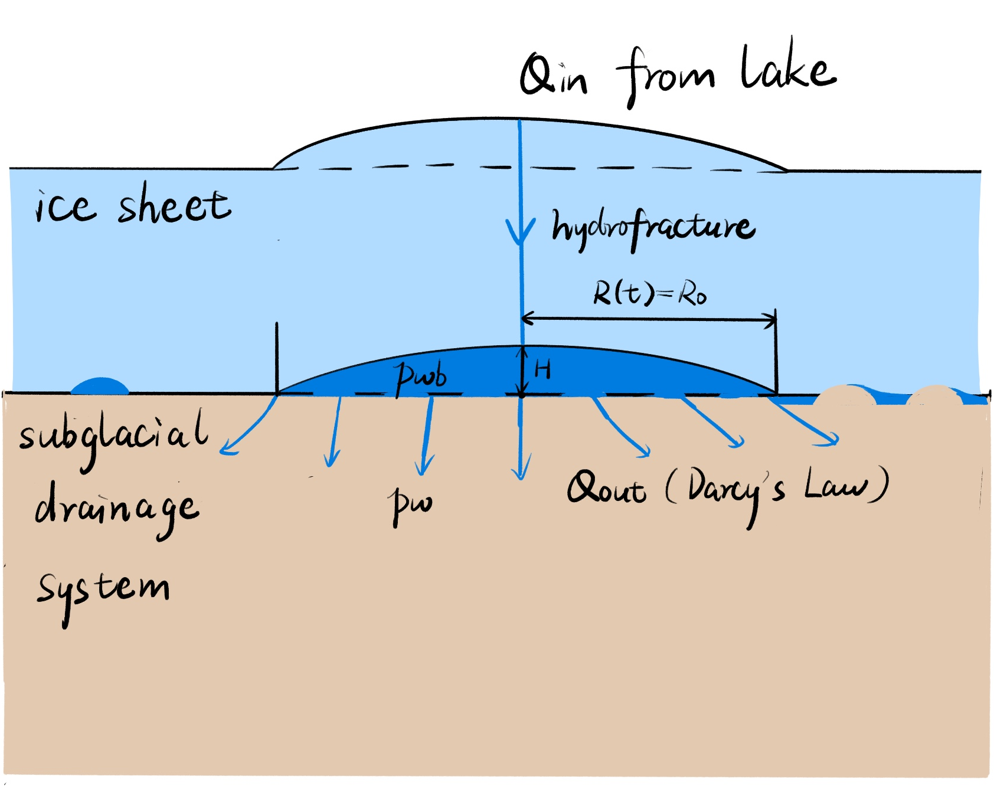
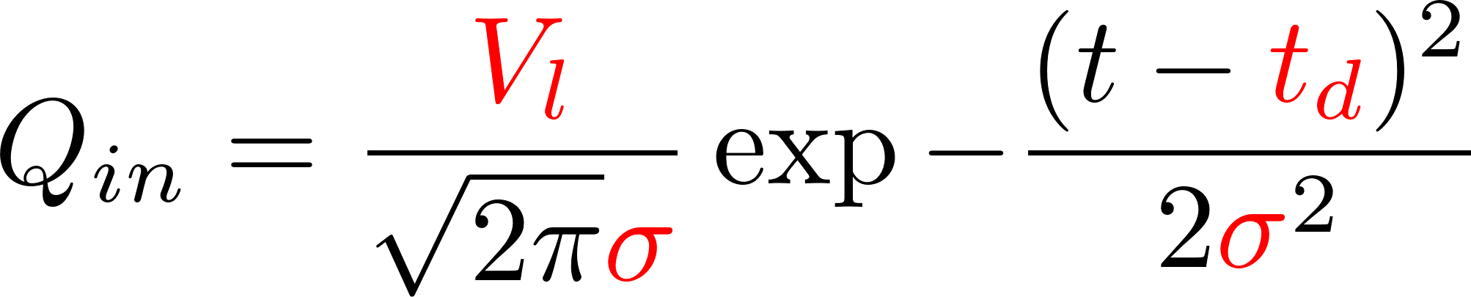
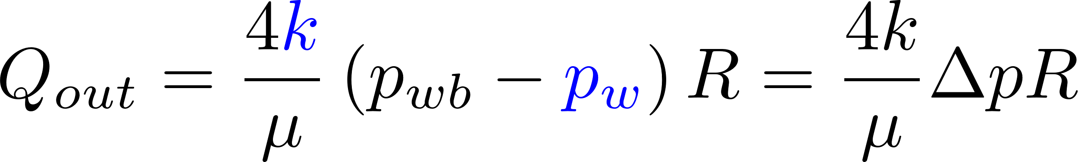
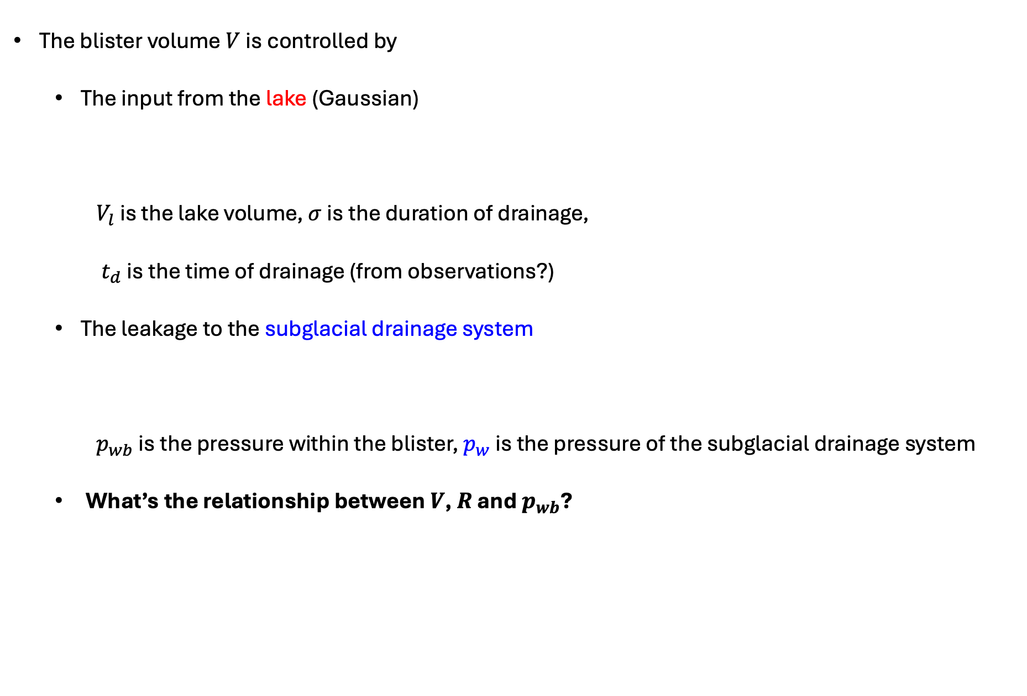
Modelling a subglacial blister
The blister volume $V$ is controlled by
The input from the lake (Gaussian)
$V_{l}$ is the lake volume, $σ$ is the duration of drainage,
$t_{d}$ is the time of drainage (from observations?)
The leakage to the subglacial drainage system
$p_{wb}$ is the pressure within the blister, $p_{w}$ is the pressure of the subglacial drainage system
What’s the relationship between $V$, $R$ and $p_{wb}$?

Slide 6
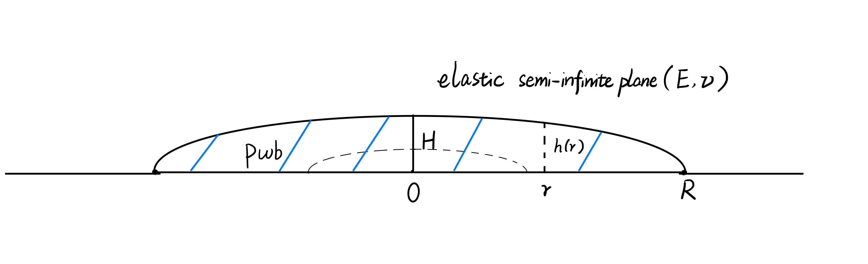
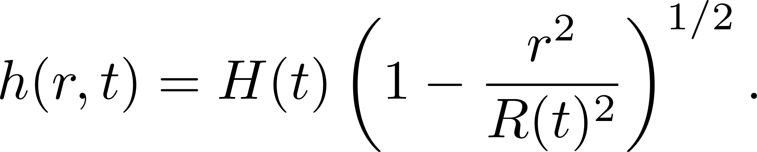
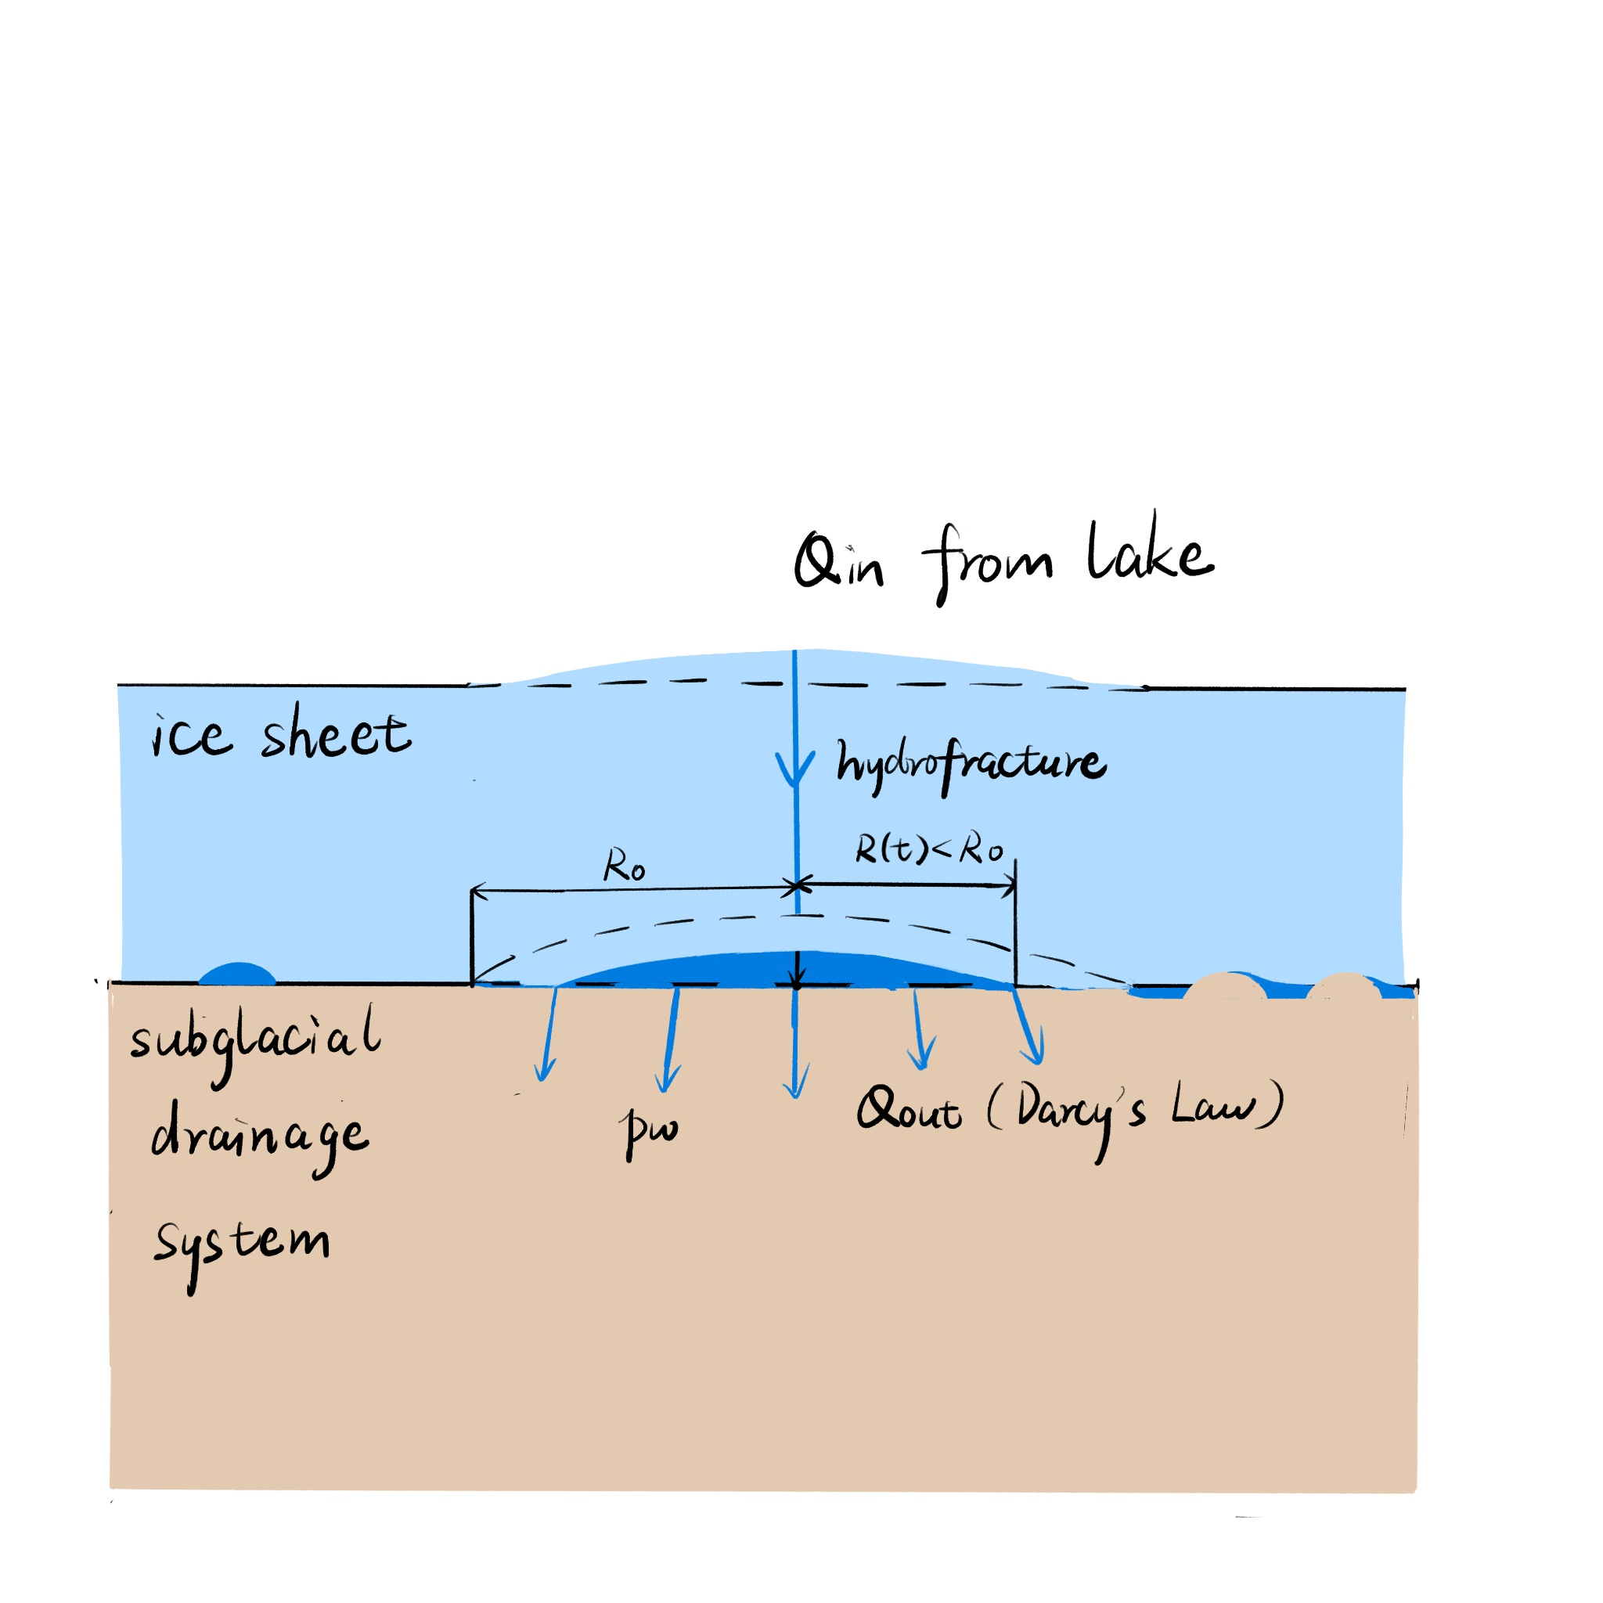
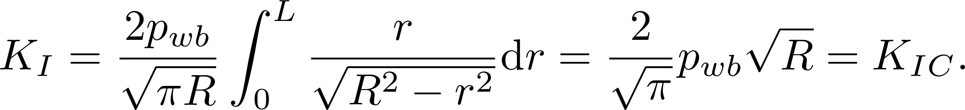
Modelling a subglacial blister
A growing blister can be modelled as a hydrofracture on the ice—bed interface
Self-similar solutions for a blister (Spence and Sharp, 1985)
Linear Elastic Fracture Mechanics (LEFM)

Slide 7
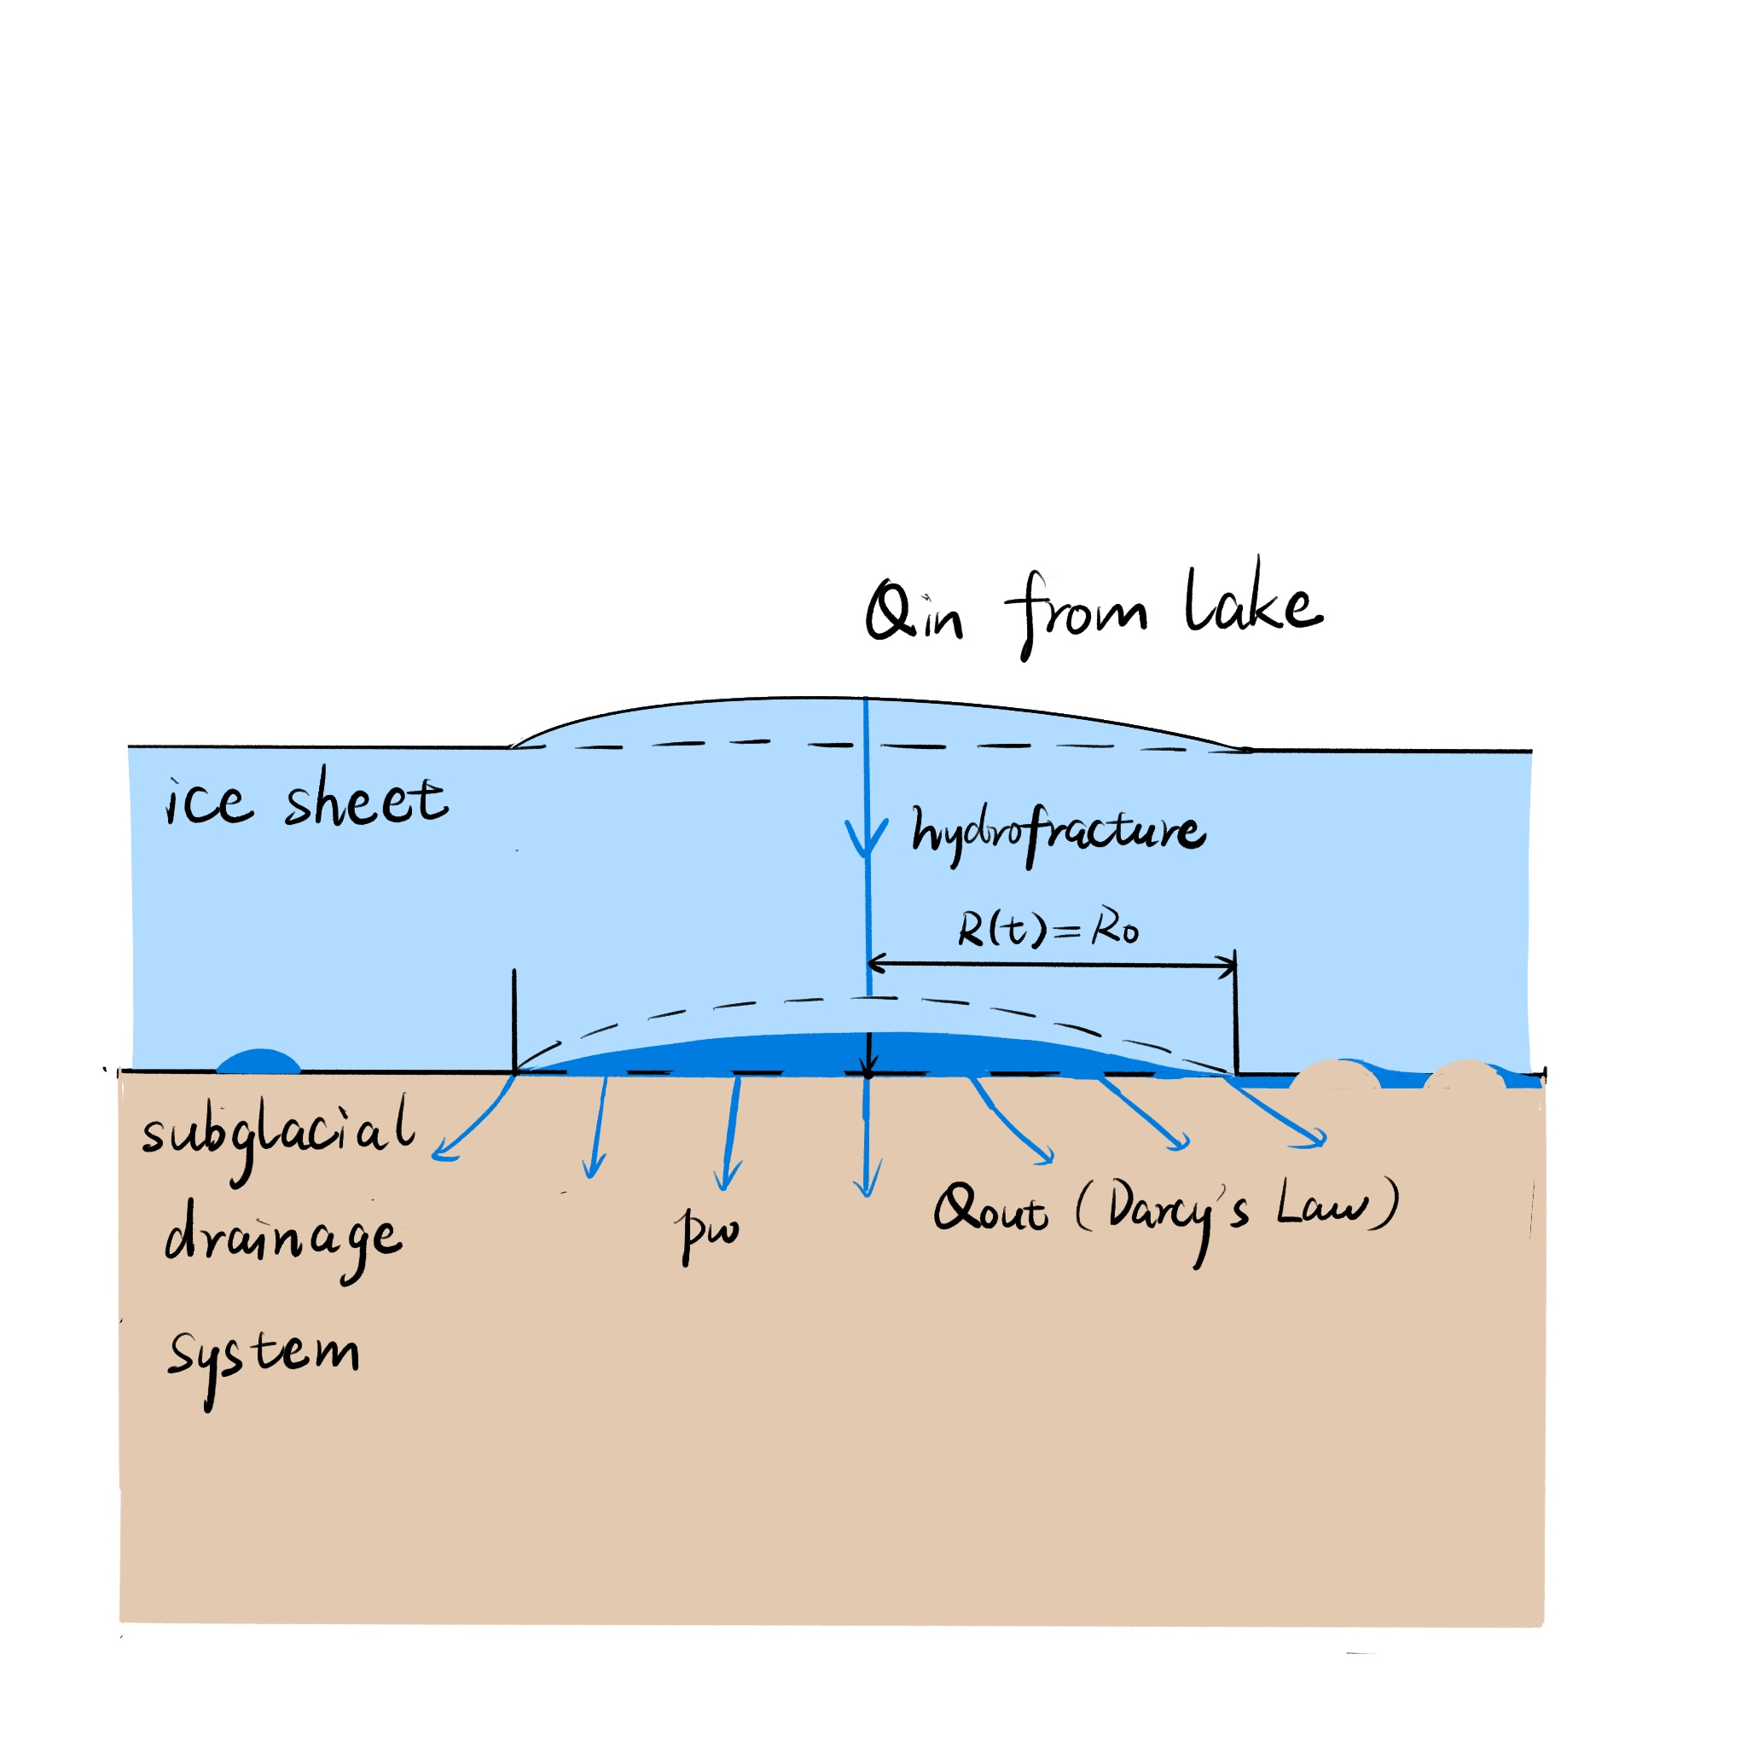
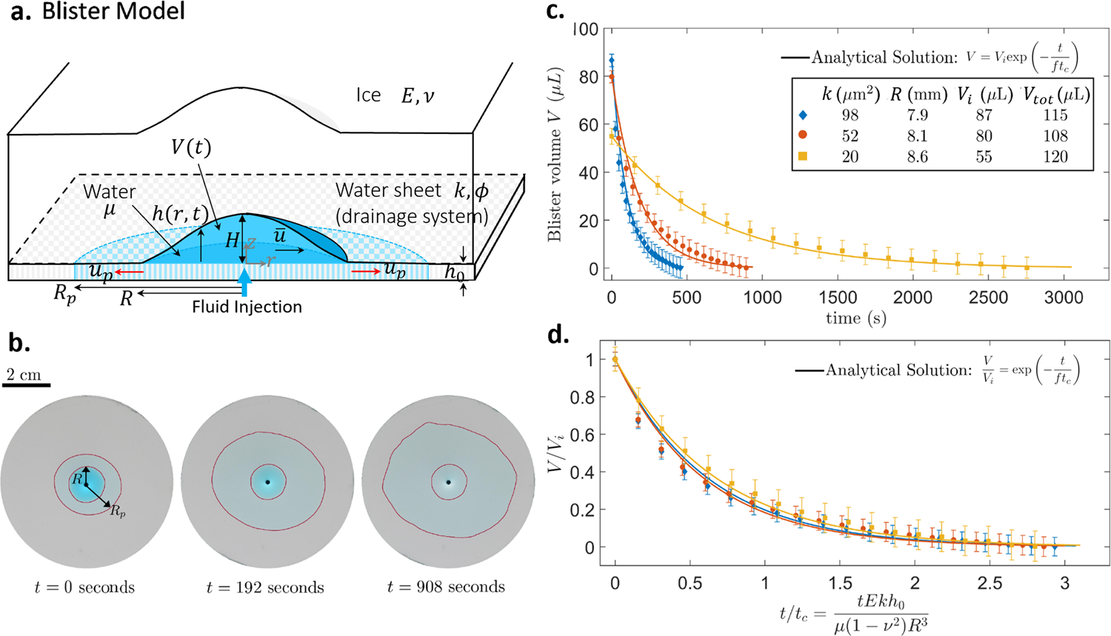
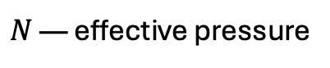
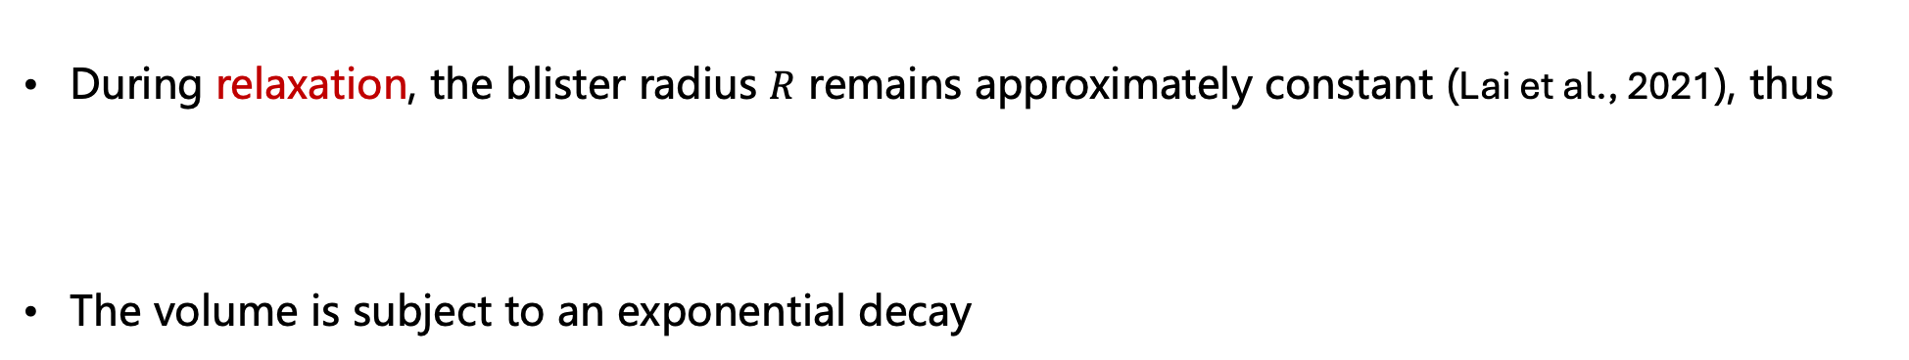
Modelling a subglacial blister
During relaxation, the blister radius $R$ remains approximately constant (Lai et al., 2021), thus
The volume is subject to an exponential decay
$N$ — effective pressure
Lai et al., 2021

Slide 8
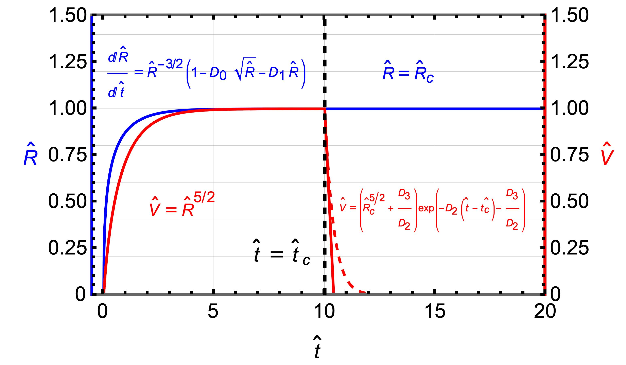
Modelling a subglacial blister
Given a constant input from a lake drainage event, the physics of a blister can be accounted for by calculating its radius and volume

Slide 9
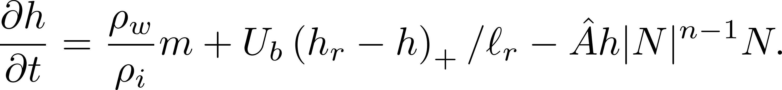
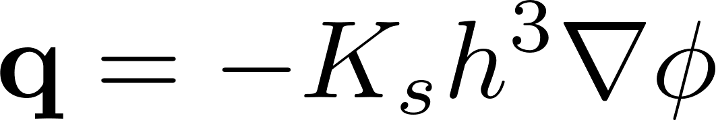
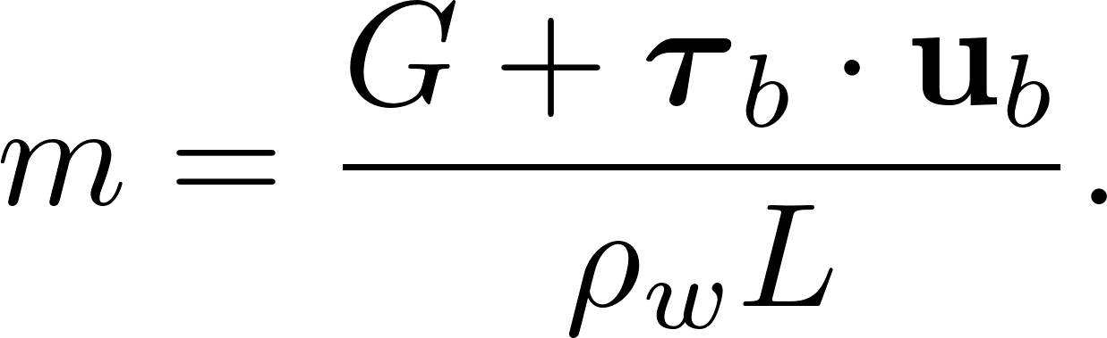
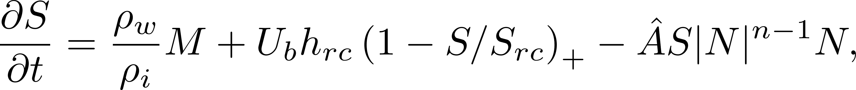
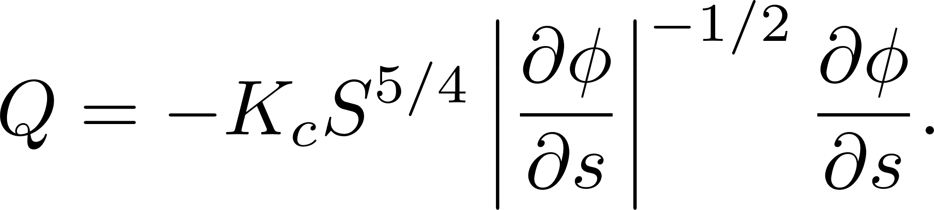
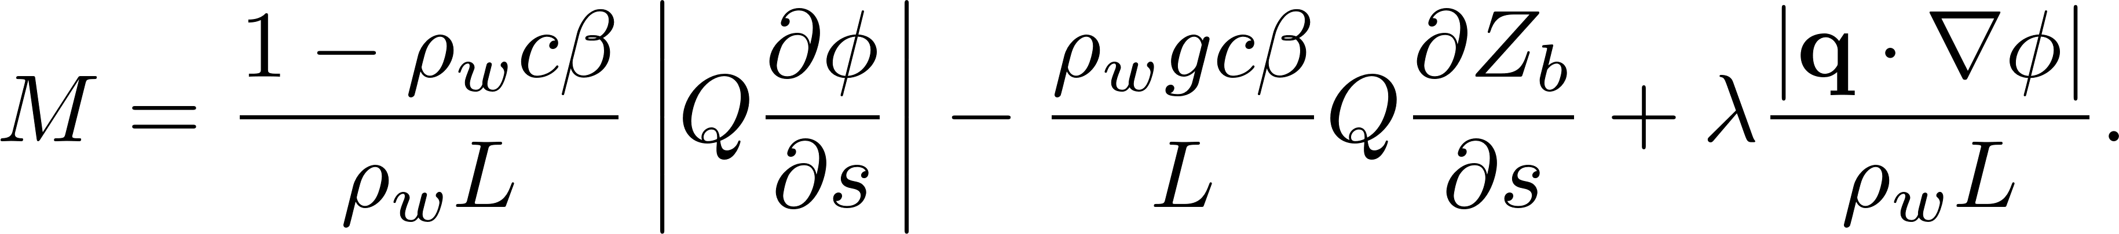
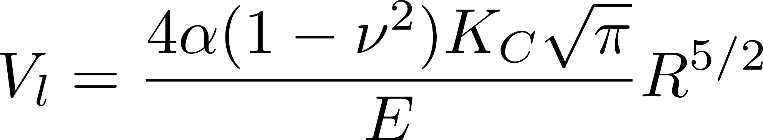

Modelling subglacial hydrology with blisters
Governing equations (Hewitt 2013)
sheet flow
channel flow
water storage
melting rates
blister leakage
moulin input
sheet
channel
“subgrid” blister
assumption: constant radius

Slide 10
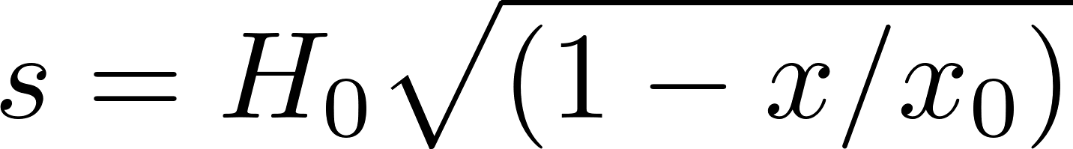
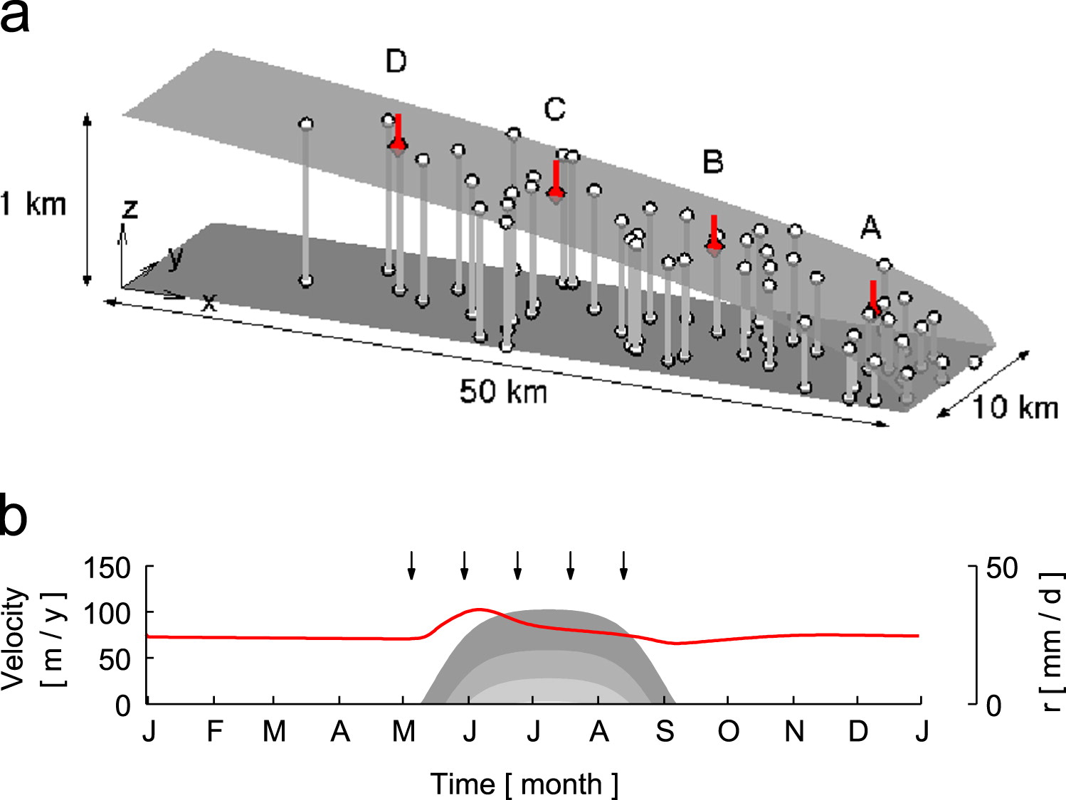

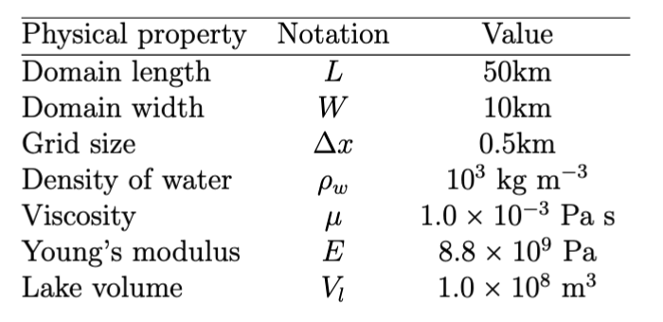
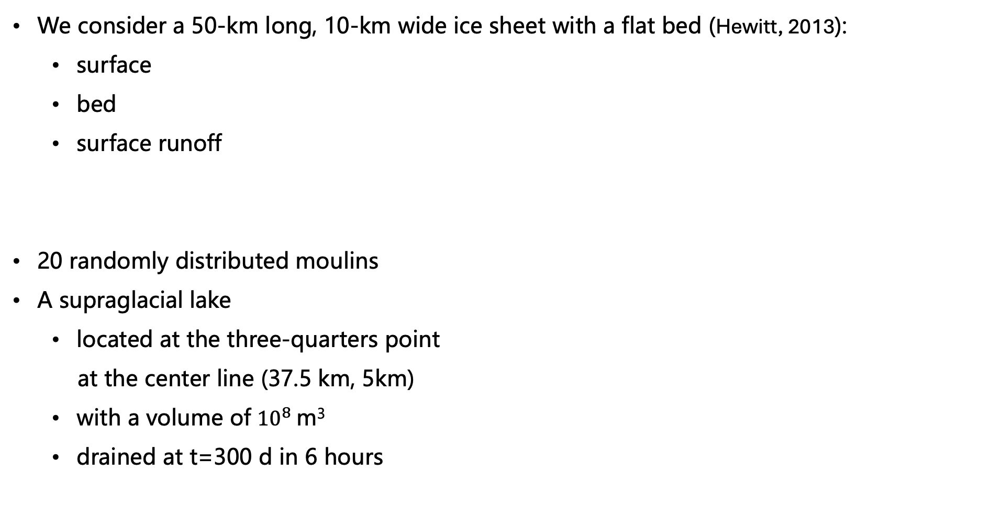
Results: 2-d subglacial hydrology without blisters
We consider a 50-km long, 10-km wide ice sheet with a flat bed (Hewitt, 2013):
surface
bed
surface runoff
20 randomly distributed moulins
A supraglacial lake
located at the three-quarters point
at the center line (37.5 km, 5km)
with a volume of ${10}^{8}$m³
drained at t=300 d in 6 hours
Hewitt, 2013

Slide 11
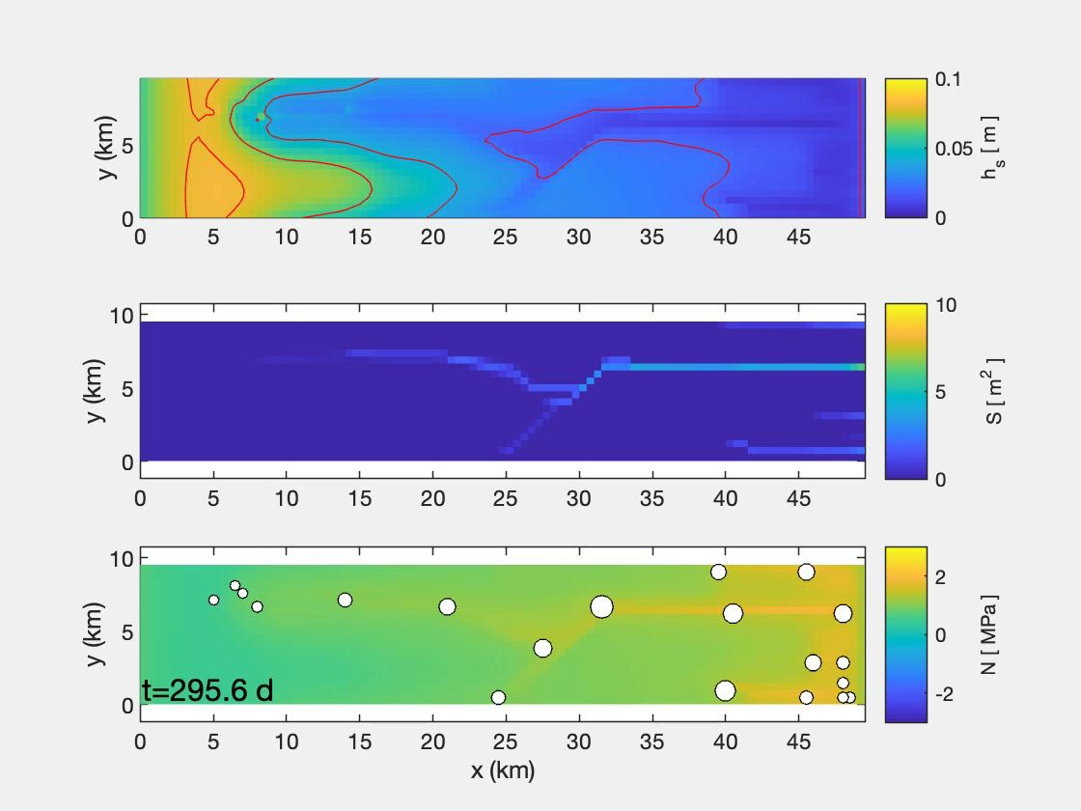
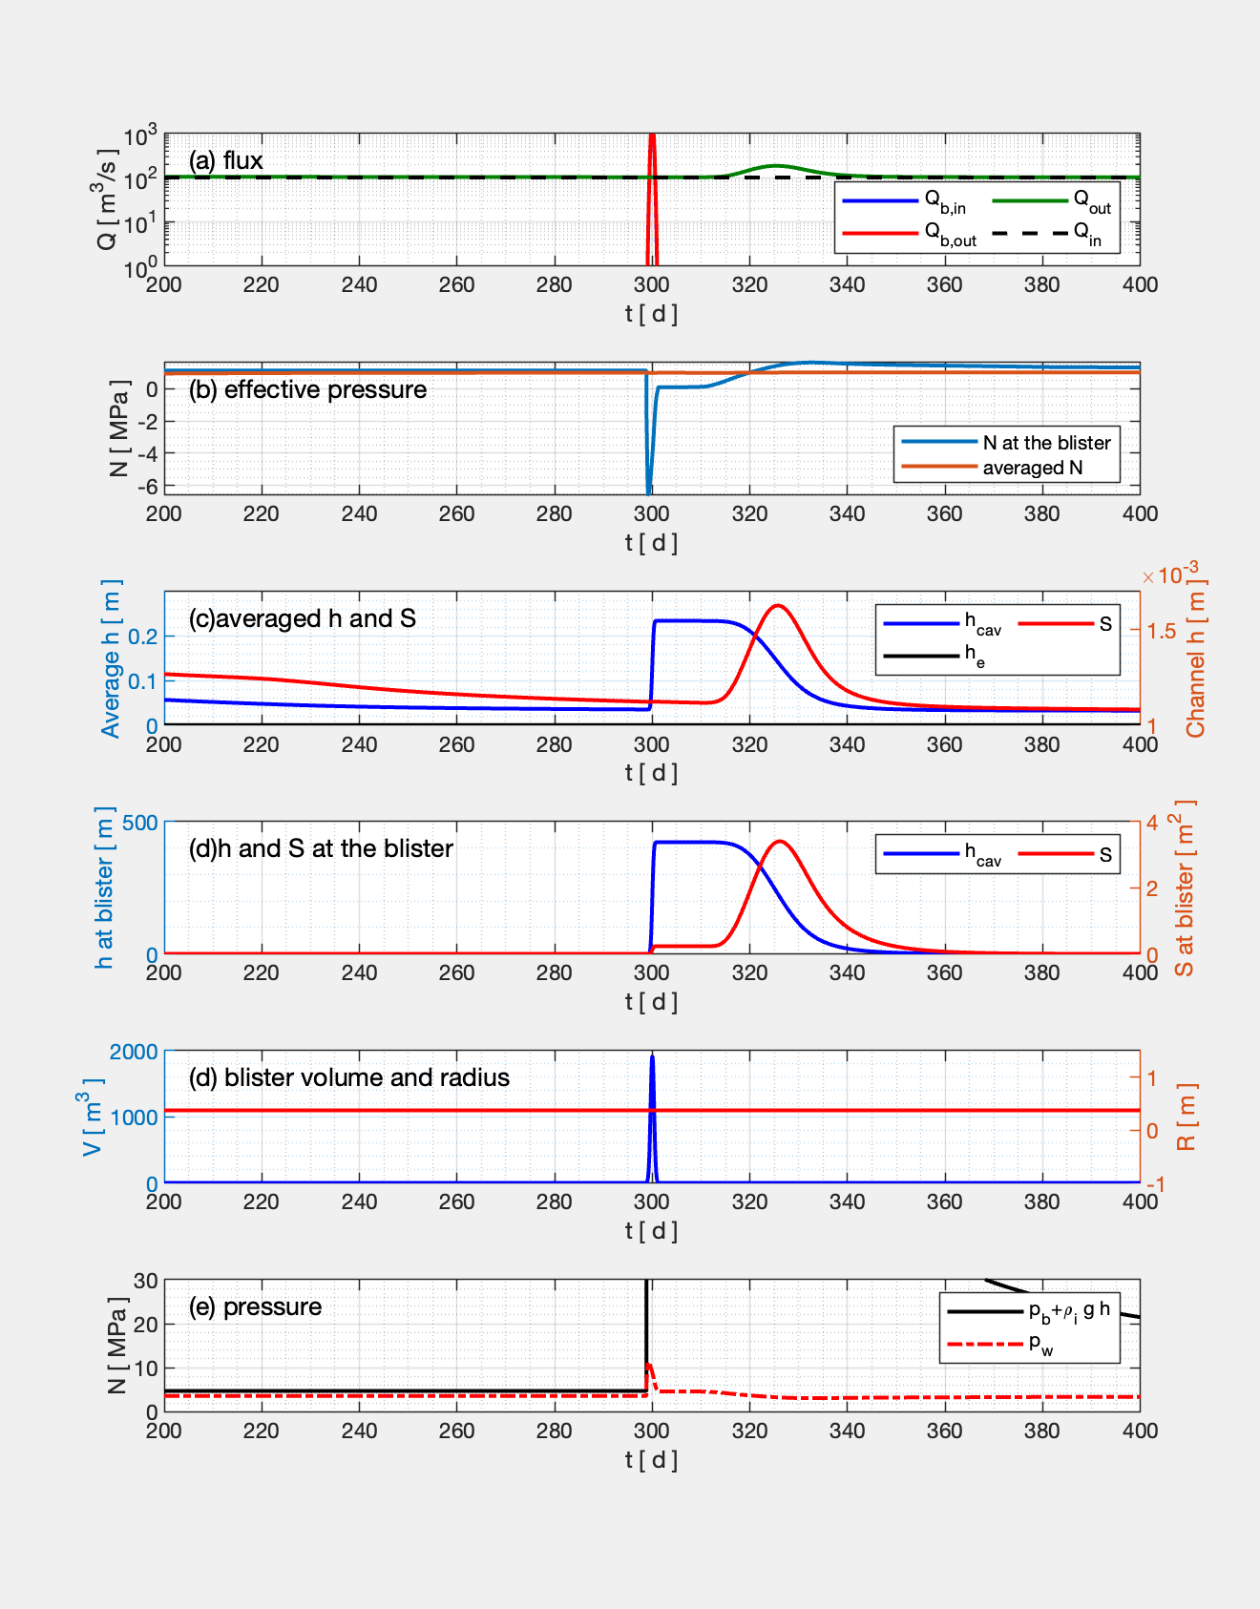
Results: 2-d subglacial hydrology without a blister
The evolution of the sheet thickness, channel cross sectional area and effective pressure
Large volume of water input causes a large sheet thickness and negative N
sheet
channel
effective pressure

Slide 12
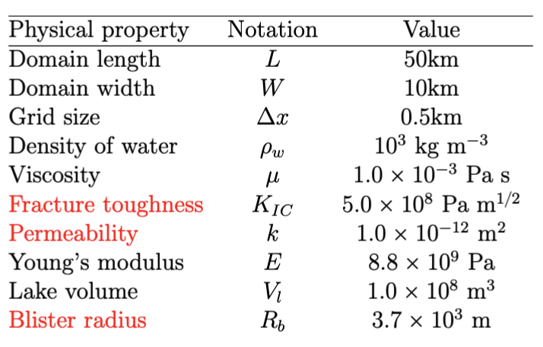
Results: 2-d subglacial hydrology with a blister
We consider a 50-km long, 10-km wide ice sheet with a flat bed (Hewitt, 2013):
surface
bed
surface runoff
20 randomly distributed moulins
A supraglacial lake drained at t=300 d
in 6 hours
A blister at the position of the lake,
represented by a single grid point
Hewitt, 2013

Slide 13

Results: 2-d subglacial hydrology with a blister
Instead of injecting the lake to the subglacial system in 6 hours, water is first injected into a blister, then flows into the subglacial drainage system in about 20 days
sheet
channel
effective pressure

Slide 14
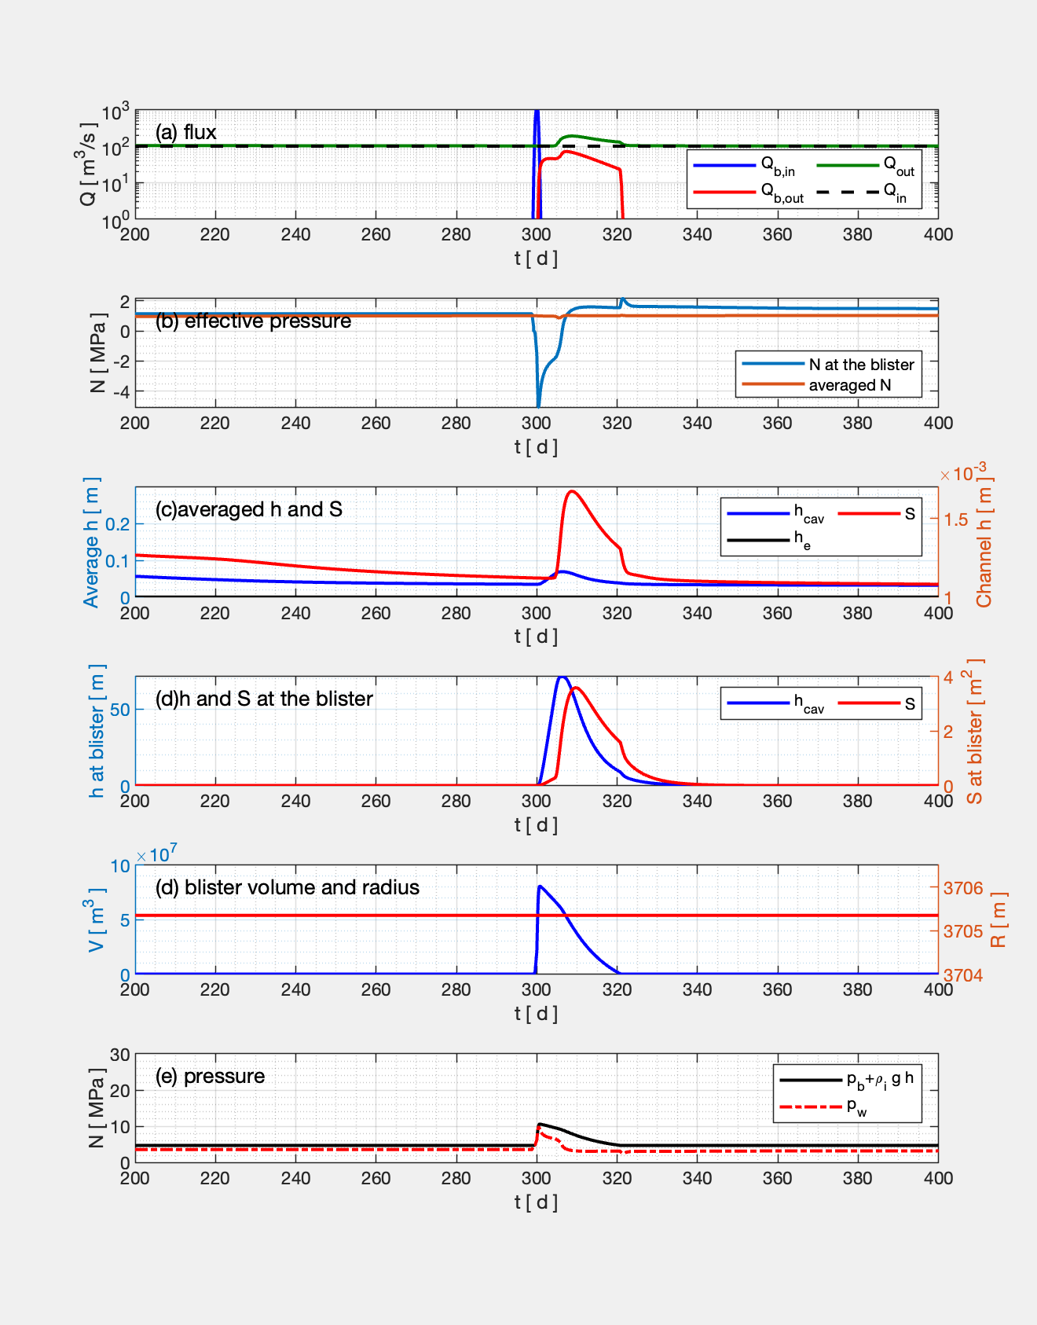
Results: 2-d subglacial hydrology with a blister
Time series
The sheet thickness becomes smaller, but is still tens of meters in magnitude
The effective pressure becomes less negative, but is still about -4 MPa at the blister

Slide 15

Results: 2-d subglacial hydrology with distributed blisters
The previous single blister is divided into multiple "small blisters" distributed around the lake
The sum of the volumes of the small blisters = the lake volume
How do we account for the blisters that are larger than a grid cell?
sheet
channel
effective pressure

Slide 16
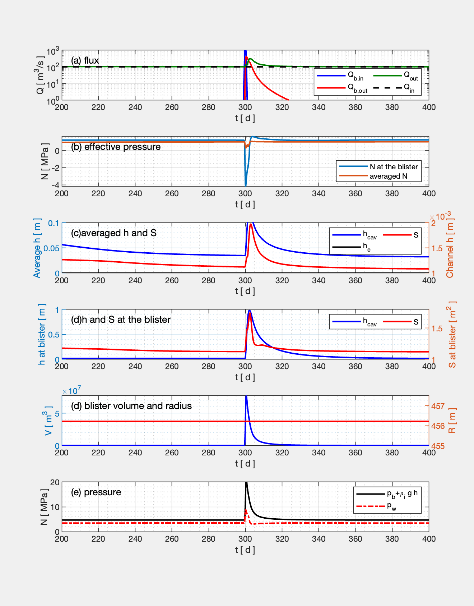
Results: 2-d subglacial hydrology with a distributed blister
Time series
The sheet thickness becomes smaller (1m in magnitude)
The effective pressure is still about -4 MPa at the blister

Slide 17
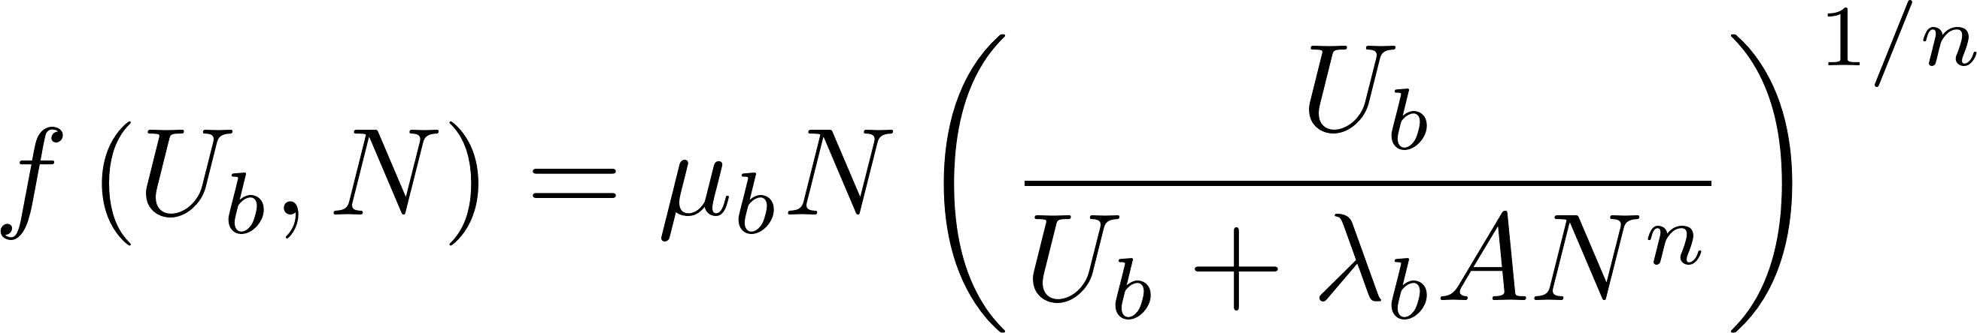
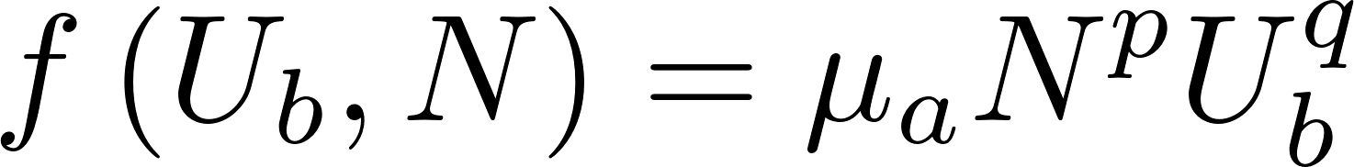
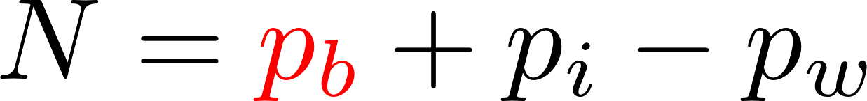
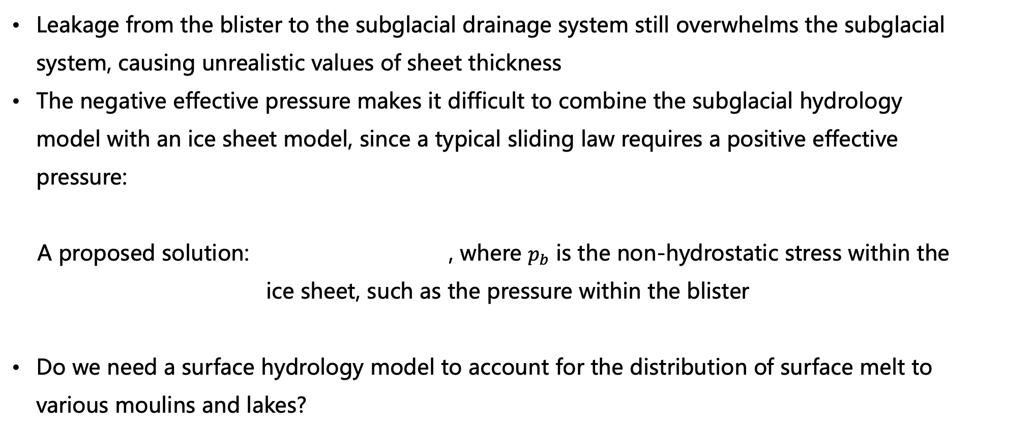
Discussion: issues with the current model
Leakage from the blister to the subglacial drainage system still overwhelms the subglacial system, causing unrealistic values of sheet thickness
The negative effective pressure makes it difficult to combine the subglacial hydrology model with an ice sheet model, since a typical sliding law requires a positive effective pressure:
A proposed solution: , where $p_{b}$ is the non-hydrostatic stress within the ice sheet, such as the pressure within the blister
Do we need a surface hydrology model to account for the distribution of surface melt to various moulins and lakes?

Slide 18
Discussion: from observations
How do we get an accurate estimate of the total volume and flow rate from a lake/moulin?
Is there a way to constrain the size of a blister, and its relaxation time?

